Slide 1
WIX1002
Fundamentals of Programming
Chapter 1
Problem Solving in Programming

Slide 2
Contents
Introduction
Java
Problem Solving
Input Process Output
Pseudocode
Flow Chart
Sample Java Program

Slide 3
Introduction
A computer can be define as an electronic machine, operating under the control of instructions stored in its own memory, that can accept data, manipulate that data and produce results that can be stored for future use.
These set of instructions is called program.
A program contains a large number of operations and a computer must be programmed to perform different tasks.
A programming language can be divided into machine language, assembly language and high level language.

Slide 4
Introduction
Machine Language
  It is the natural language of a particular computer.
  It is defined by the hardware design of the computer.
  It consist of strings of number (0 and 1) that construct computers to perform their operations.
  It is machine dependent, particular machine language can be used only for one type of computer.
  It is cumbersome for humans.

Slide 5
Introduction
Assembly Language
  It is the English-like abbreviations languages.
  Translator programs called assemblers were developed to convert assembly language programs to machine language at computer speeds.
  It is more clearer and more easier to understand as compare to machine language.
  However, it requires many statements in order to perform a simple tasks.
  Example, MOV AL, 88h

Slide 6
Introduction
High Level Language
  It is developed to speed the programming process.
  It was developed in which single statements could be written to accomplish substantial tasks.
  Compiler is used to convert high level language programs into machine language.
  High level languages allow programmers to write instructions that look almost like everyday English and contain commonly used mathematical notations.
  Java is one of the High Level language.

Slide 7
Java
Java is an Object-Oriented Programming language.
In OOP, all the things around us is made up of objects, such as people, buildings, vehicles, and etc. Each of the object will has the ability to perform certain actions and these actions will has some effect on some other objects in the world. Example a people driving a car.
Java is a well-know programming language for different applications such as console application, desktop application, distributed application, Internet application and mobile application.
Besides, Java can be used to develop Java applet which can be executed in Web browser or applet viewer.

Slide 8
Java
Java programs normally go through five phases to be executed. These are: edit, compile, load, verify and execute.
Phase 1 - Edit
  This phase consists of editing a file. This is accomplished with an editor program or Integrated Development Environment (IDE). Some of the popular IDE includes NetBeans, Eclipse, Jcreator and JDeveloper.
  Java program file names end with .java extension. The file name must be same as the Class name.

Slide 9
Java
Phase 2 – Compile
  In this phase, the Java compiler translates the Java program into byte codes. The compiler will check whether the source code has the correct spelling and punctuation, all the data types are correct, and all the variables names are legal.
  Java Platform (JDK 15) provides a compiler you can use to compile all kinds of Java programs.
  Command use to compile java file
    javac filename.java
  Syntax – The grammar rules of the language. It tells what arrangement of words and punctuations are allowed in a Class or program definition.

Slide 10
Java
Phase 3 – Load
  The class loader will take the .class file containing the byte codes and transfers it to memory. Java applications are loaded into memory and executed using the Java interpreter.
  Java interpreter is sometimes referred to as the "Java Virtual Machine" or "Java run-time system".
Phase 4 – Verify
  In this phase, the byte code verifier is used to verify the byte code before executed. It ensures byte codes do not violate security requirements.

Slide 11
Java
Phase 5 – Execute
  After verification, the computer will interpret the program one byte code at a time, thus performing the actions specified by the program.
  Command use to execute java file
    java filename
  A Java Achieve (JAR) file can be created for a Java application that consists of multiple java files.
  Command use to execute jar file
    java –jar filename.jar

Slide 12
Problem Solving
The purpose of writing a program is to solve a problem or performing certain tasks.
Before writing a program to solve a problem, it is essential to have a clear understanding of the problem and a carefully planned approach to solve a problem.
Any computing problem can be solved by executing a series of actions in a specific order.
A procedure for solving a problem in terms of the actions to be executed and the order in which actions are to be executed is called an algorithm.

Slide 13
Problem Solving
Below are the general steps of problem solving in programming
  First, understand the problem. Solve the problem manually with a few examples.
  Then, devise an algorithm to solve the problem.
  After that, write the program using the programming syntax and compile the program.
  Correct the syntax error after the compilation. Save the program and compile again.
  Execute the program if the program is error free.
  Finally test the results against expected output. If the results are not correct, modify the algorithm, rewrite and recompile the program

Slide 14
Problem Solving
Strategies
  What do I know about the problem?
  What is the information that I have to process in order the find the solution?
  What does the solution look like?
  What sort of special cases exist?
  How will I recognize that I have found the solution?

Slide 15
Problem Solving
Syntax – A set of rules, principles, and processes that govern the structure of statement in a programming language.
Semantic – Describe the meaning of the things written while following the syntax rules of the language. Semantic describes the things happen when a program is executed.
Debugging – A process of eliminating mistakes in the program. A mistake in a program is called a bug.

Slide 16
Problem Solving
There are three commonly types of bugs or errors.
Syntax Error
  A grammatical mistake in the program. A mistake in the arrangement of words and punctuations.
Logic Error
  A mistake in the underlying algorithm or semantic error.
Run-time Error
  An error that happen when the program is executed

Slide 17
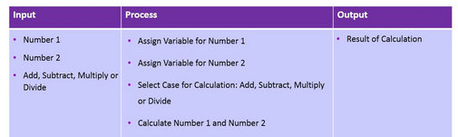
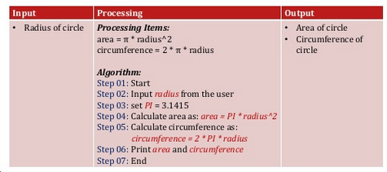
Input Process Output
A program usually receives inputs from a user or other source (files), does some computations on the inputs (process), and returns the results of the computations (output).

Slide 18
Pseudocode
Pseudocode is an informal high-level description of the operating principle of a computer program or algorithm. It is simply a numbered list of instructions to perform some task.
Best Practices
  Write only one statement per line and each statement should express just one action.
    Get the name of the participant.
    Compute the total salary.
    Display the number of students.

Slide 19
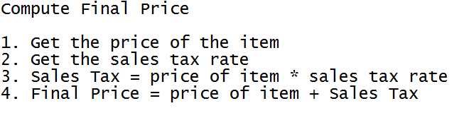
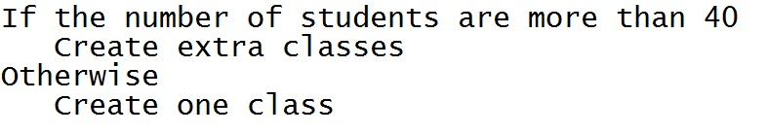
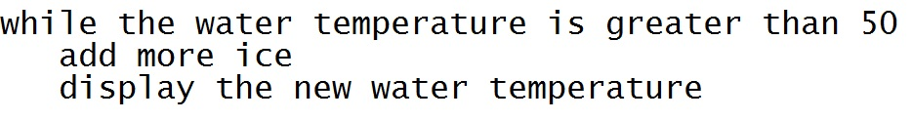
Pseudocode
  Indent statements that fall inside a selection or loop structure.

Slide 20
Flow Chart
A flowchart is a type of diagram that represents an algorithm or process.
A flow chart shows the steps as boxes of various kinds, and their order by connecting them with arrows.
It is used in analysing, designing, documenting or managing a process or program.

Slide 21
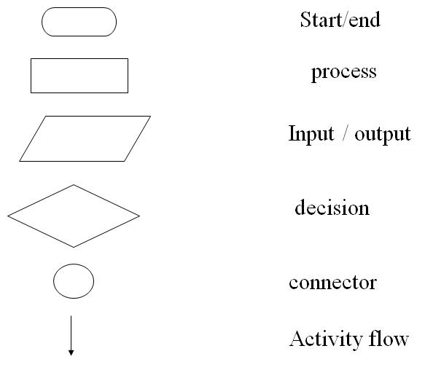
Flow Chart
Flow Chart Notation

Slide 22
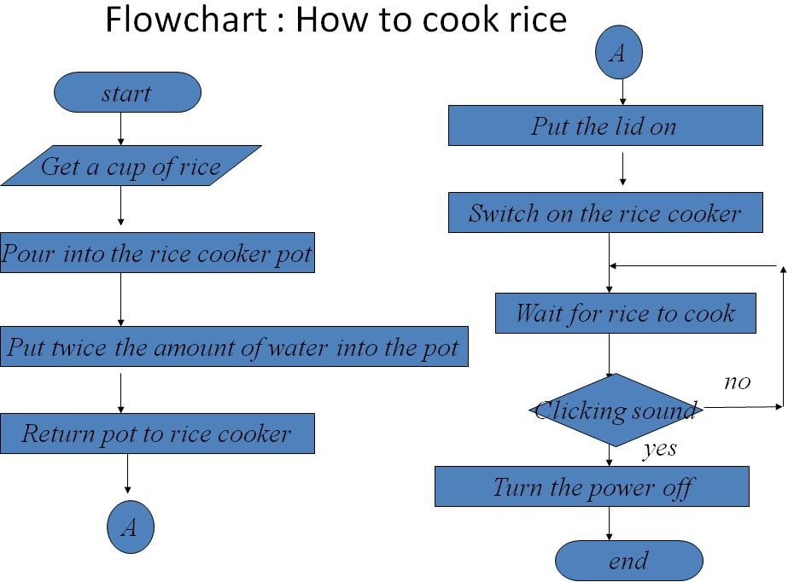
Flow Chart

Slide 23
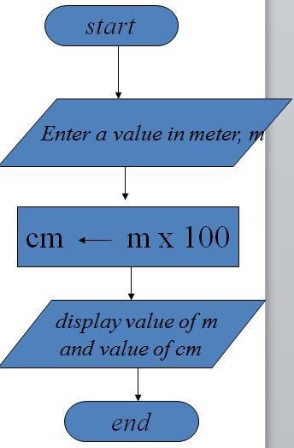
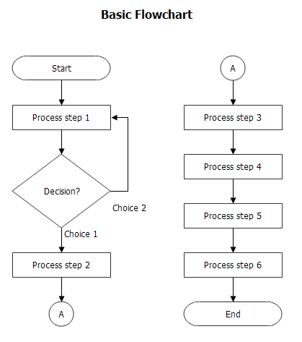
Flow Chart

Slide 24
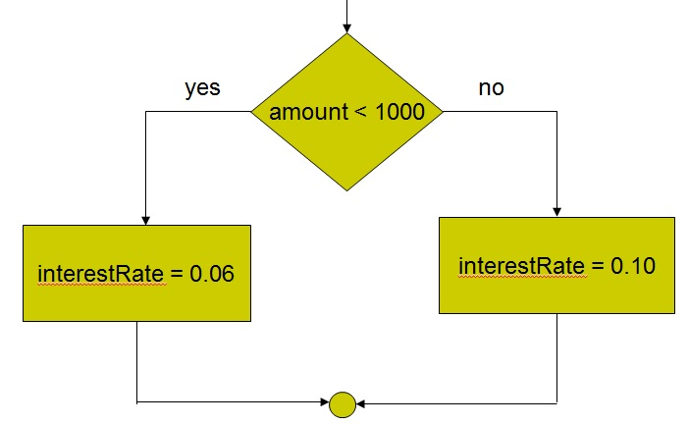
Flow Chart
Selection Structure

Slide 25
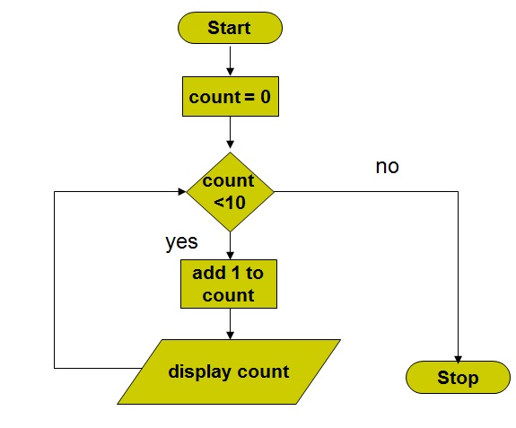
Flow Chart
Repetition Structure

Slide 26
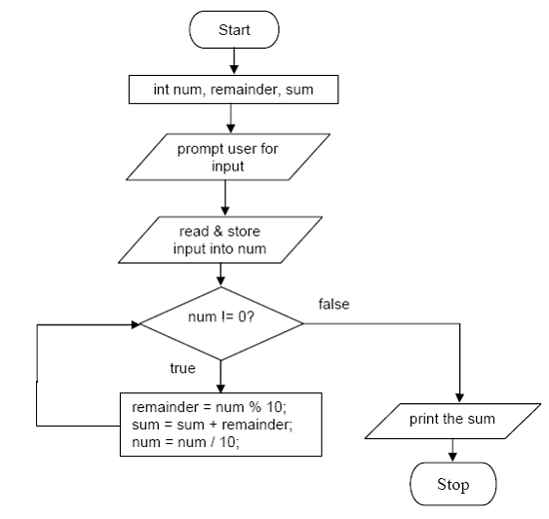
Flow Chart

Slide 27
Sample Java Program
public class FirstProgram
{
public static void main(String[] args)
{
System.out.println("Welcome to Java!");
}
}
* File Name: FirstProgram.java

Slide 28
Sample Java Program
Every program in Java consists of at least one class definition. The class name of the program is FirstProgram.
A left brace { - begins the body of every class definition. A right brace } - ends each class definition.
The class contains a method named main. When the program is run, the main method is invoked which means the statements in the main method are executed.
The void indicates that this method will perform a task and will not return any information when the task is completed.
The statement in the sample program display the output Welcome to Java!

Slide 29
Sample Java Program
In Java:
  A program is made up of one or more classes
  A class contains one or more methods
  A method contains program statements
Java is case sensitive. The uppercase letters and lowercase letters must be enter correctly.
Class are the fundamental building blocks of Java program. Each program begin with a class definition.
Every Java application contains a main method. The instructions in the main method are executed when the application starts. main method must always be static.
Each Java statements must end with a semicolon (;)

Slide 30
